Slide 1
WCS Show and Tell – Rotation 1 (NSPD)
31 July, 2020

Slide 2
Our Team – Non-Site Product Data (NSPD)
Aarti Shrimal – Delivery Manager
Charlotte Needes – Product Owner
Sundeep Jagatia – Business Analyst
Adam Gizaw, James Cook, Amin Ayoub – Graduates / Interns
Vijay Prajapati, George Hemmerde, Nagarajan Paulperiyasamy, Trevor Huckstep, Vijay Pail, Shinu Suresh, Hemant Goyal, Dharmendra Singh, Venkatesh Sundararaj – Software Engineers / Developers
Shubham Jain, David Odebade, Sai Jaya Vardhan Reddy Gajjala – QA Engineers / Testers

Slide 3
Our Team Function – Non-Site Product Data (NSPD)
Previously known as Team Guerrilla, NSPD was formed last year (September 2019)
NSPD works with the internal business and performs data extraction tasks
Notes:
The business calls these APIs to get the information that they need
Team Guerrila used to be associated with SEO (search engine optimisation)
NSPD still does these tasks but for the internal business, while Site Data works with customers

Slide 4
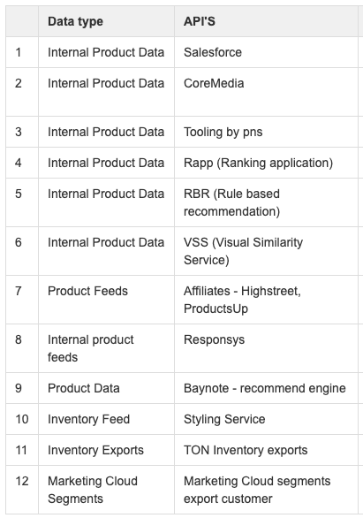
NSPD APIs

Slide 5
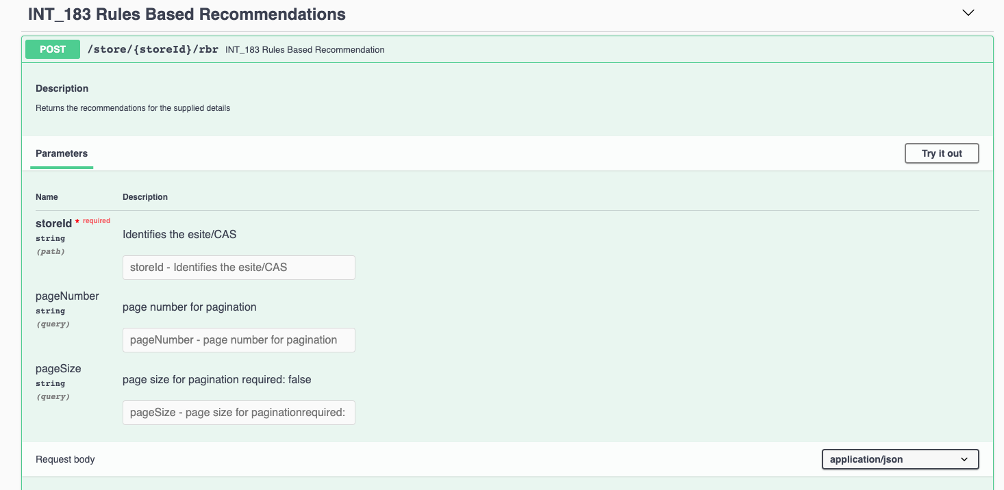
An example of our internal APIs – Rules Based Recommendations (RBR)
On the PDP, the RBR API is used to load products that are of the same colour, category and other criteria provided in the input request

Slide 6
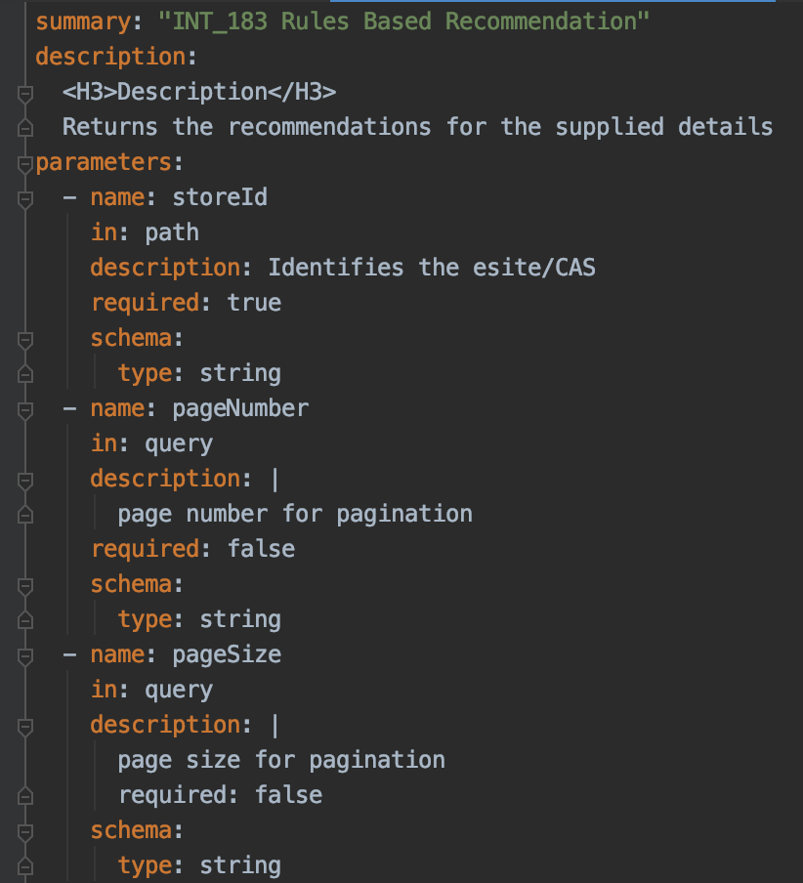

Slide 7
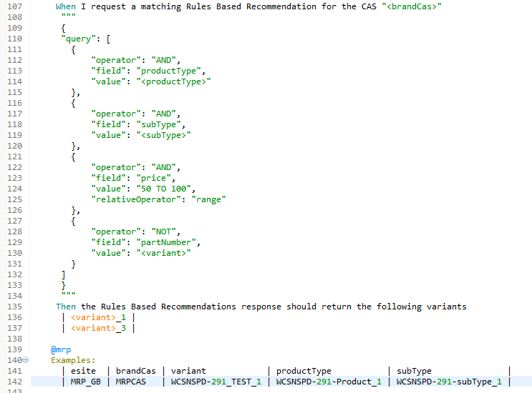
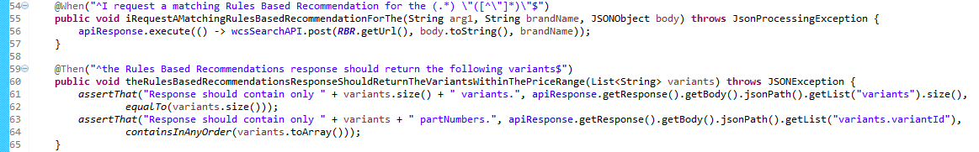
WCSNSPD-291: Add price to the RBR API Request
Notes:
Ticket involved adding price to the RBR API request, this allows the business to search the price by range, exact match, more than & less than.
Created scenarios based on different price operators (four above) and tested these through feature files and step definitions.
Above scenario is checking for prices within a certain range. We provide a range of 50 to 100, and multiple variants. Based on the range provided, the scenario should only return two out of three variants.
The step definitions execute and assert the logic of the scenario.

Slide 8
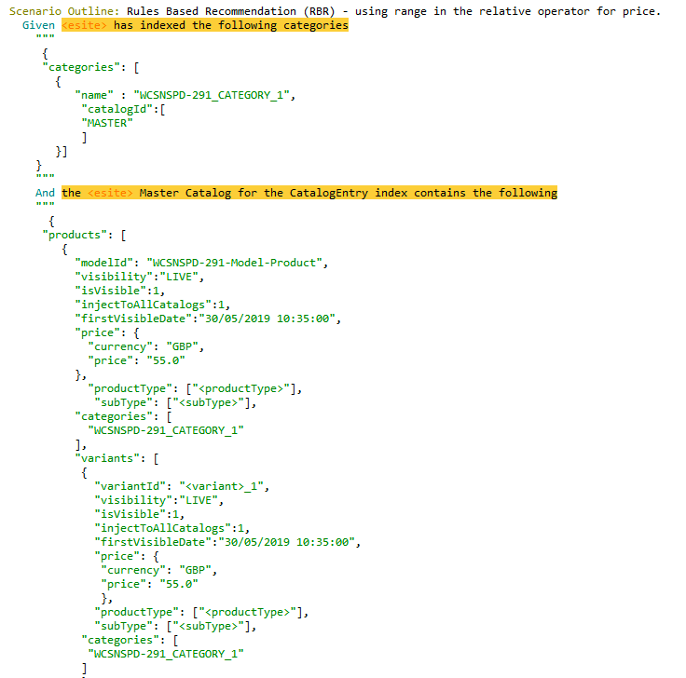
WCSNSPD-291: Data Assured

Slide 9
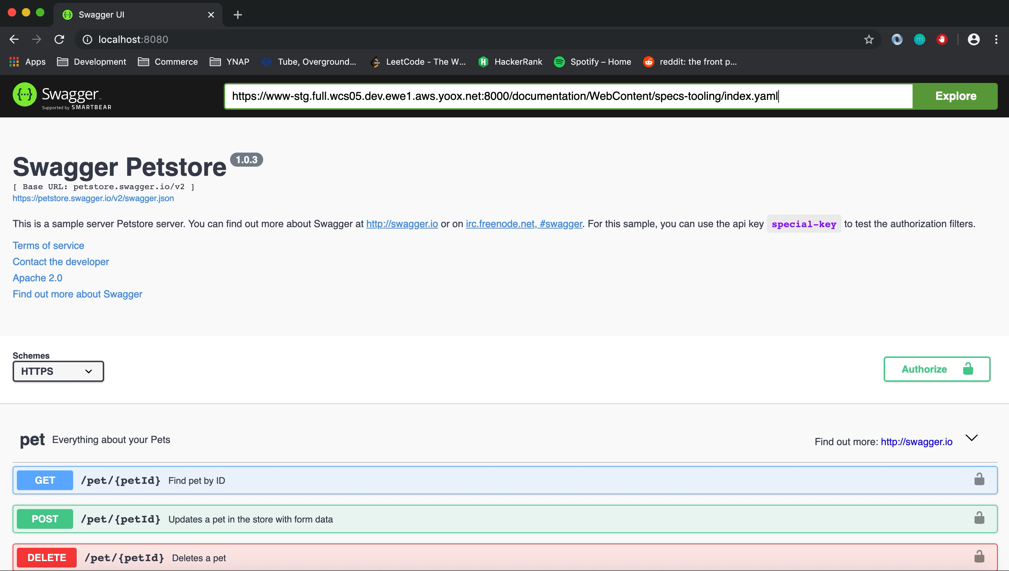
WCSNSPD-380: Swagger Documentation Open API 3.0
Notes:
Writing .yaml files to document the internal APIs that the business uses.

Slide 10
Learning Process
JIRA tickets and pairing
Pluralsight and Udemy
The most effective way has been through being assigned to a ticket, and gaining an understanding on the job
Notes:
JIRA tickets: being assigned to a fairly low complexity ticket (story points 1-5) and working with other developers to understand how things
Pluralsight/online resources: covering concepts that we aren’t confident on and applying it when possible

Slide 11
Amin Ayoub
amin.ayoub@ynap.com
Adam Gizaw
adam.gizaw@ynap.com
Follow us:
@ynap
www.ynap.com
YOOX NET-A-PORTER GROUP
Thank you

